Slide 1
Recent results from Odessa Observatory
Yuri Sumaruk , Vitaly Starostenko
Institute of Geophysics, National Academy of Sciences of Ukraine, Kiev, Ukraine

Slide 2
Historical events I
1859-1875 Inclination and horizontal component were measured near Odessa and along the Black Sea by Dikov.
1880-1886 Magnetic observations along the coast of the Black Sea were performed under the leadership of Baron Maidel.
1890-1891 Isocline map of Odessa anomaly was published by Prof. Popruzhenko

Slide 3
Historical events II
In 1894 the Odessa meteorological observatory began regular magnetic observations. The magnetic pavilions on the Maloy Fontane had been built by Prof. Klossovsky
1924 - Geophysical observatory “Odessa”
1931 – The observatory was transferred by 60 km from Odessa to Stepanovka.
3

Slide 4
Historical events III
Since 1948 regular observations of the geomagnetic field components have been made at the observatory with La Cour magnetometers.
In the 1970s Bobrov magnetometers were installed.
4

Slide 5
Geomagnetic observatory Odessa Fluxgate magnetometer LEMI-018M
5

Slide 6
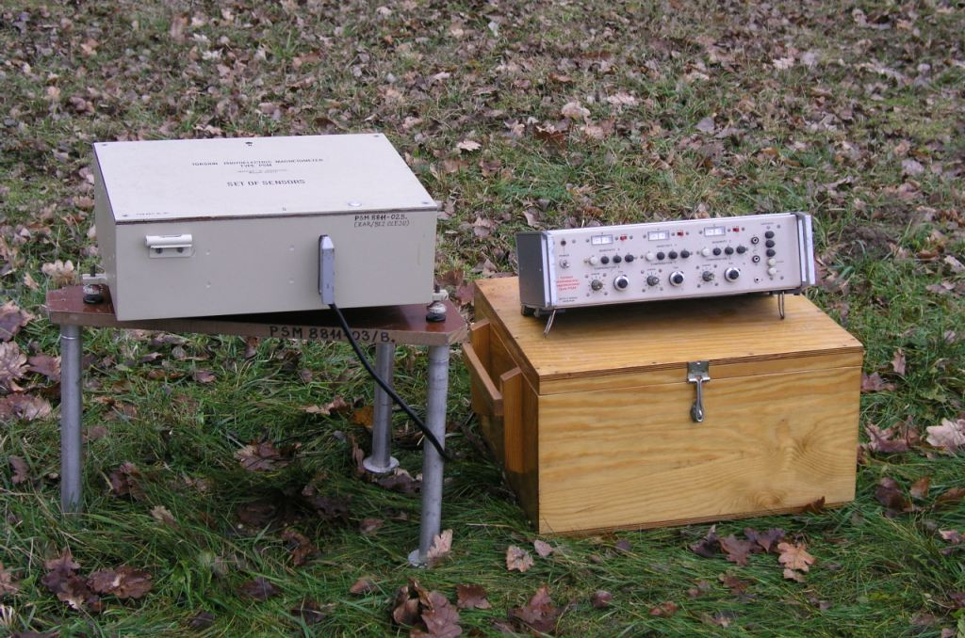
Geomagnetic observatory Odessa Torsion photoelectric magnetometer
6

Slide 7
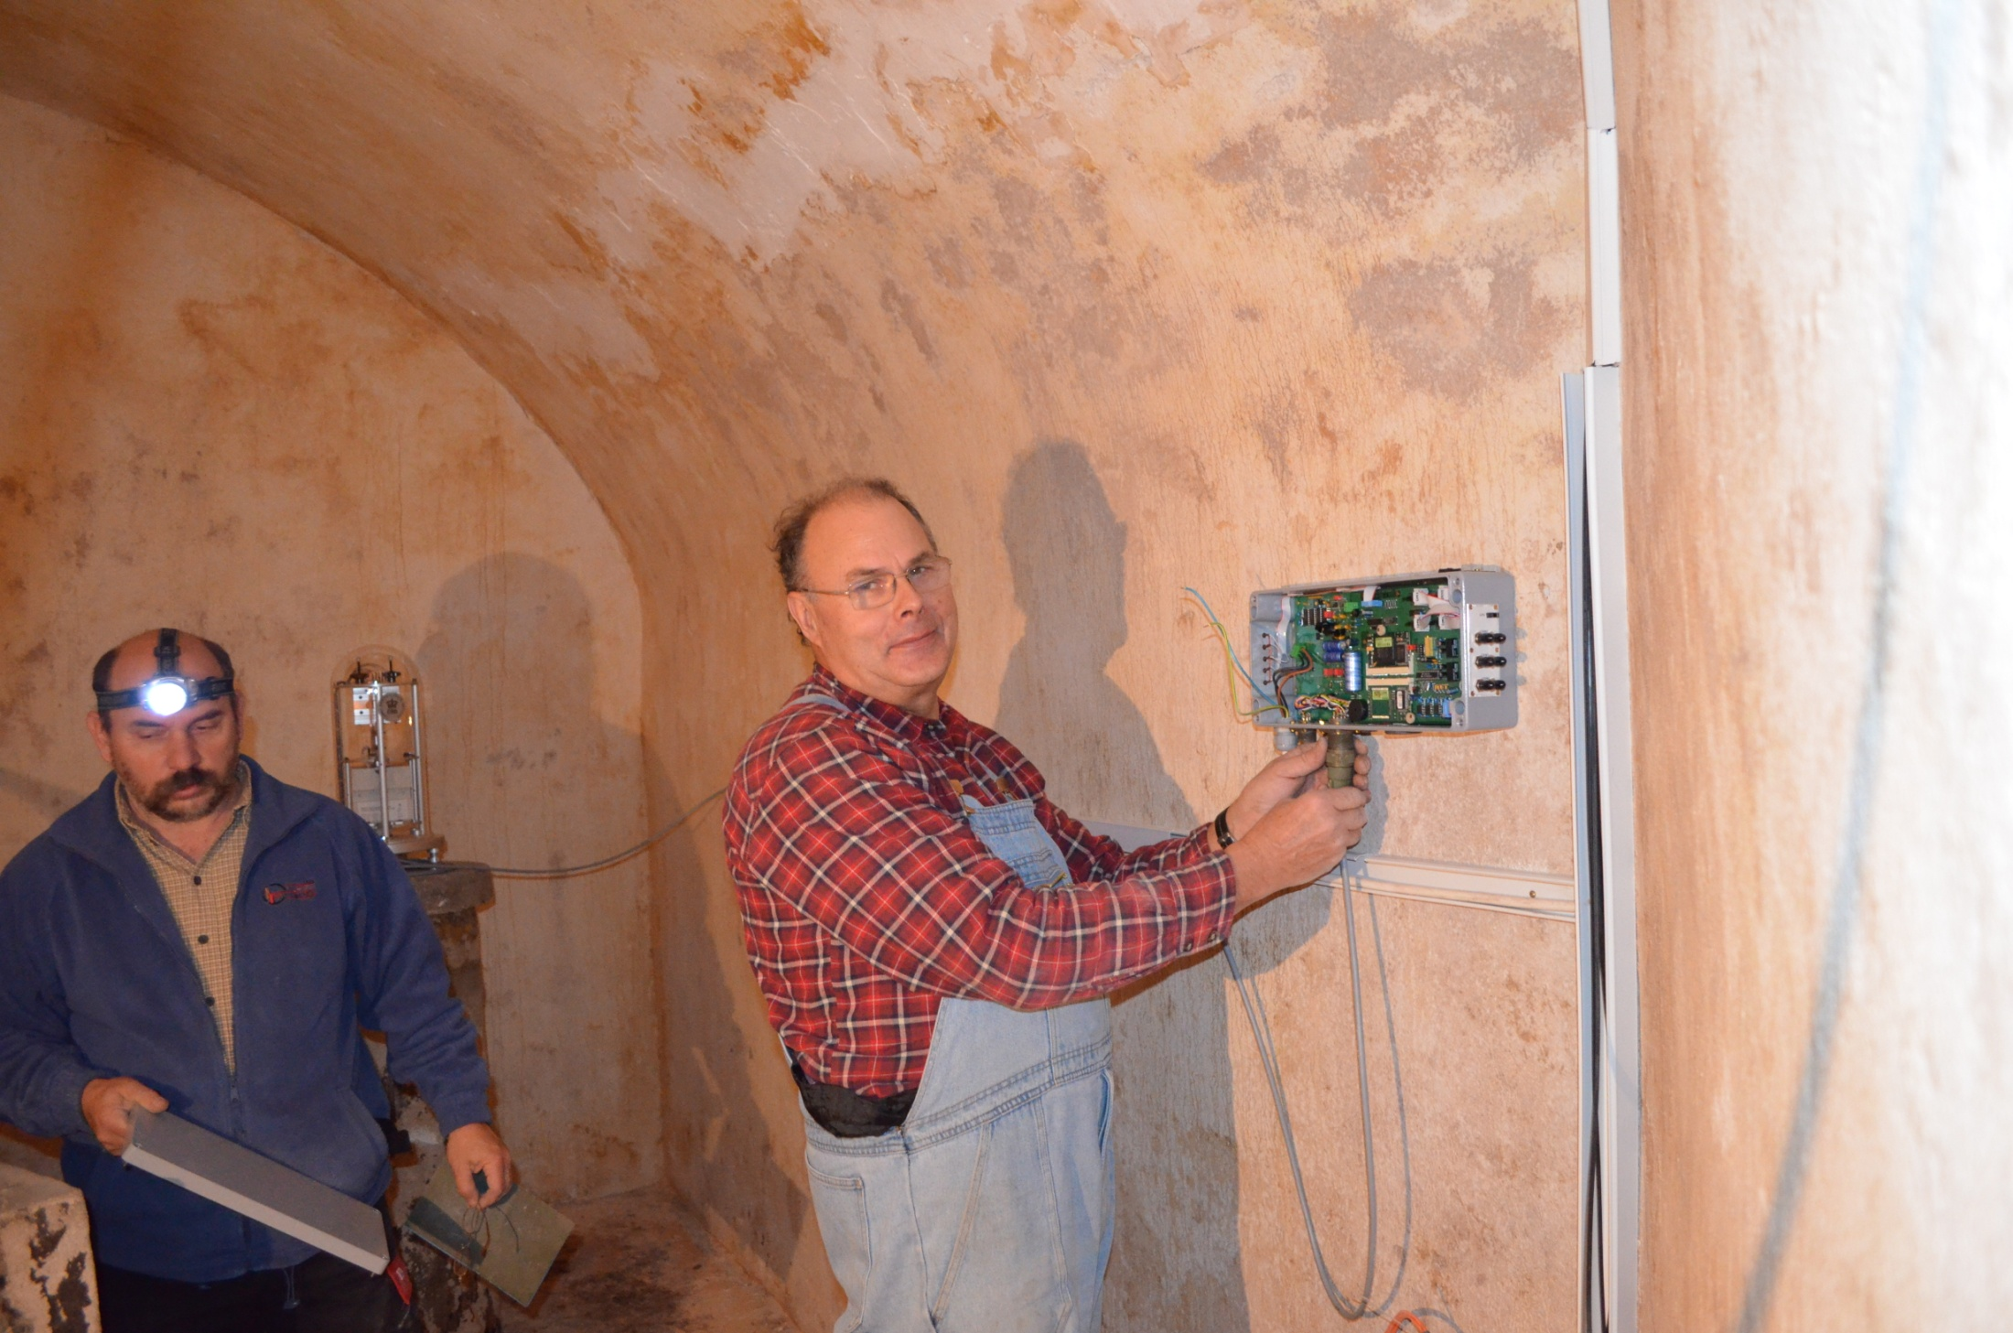

Slide 8
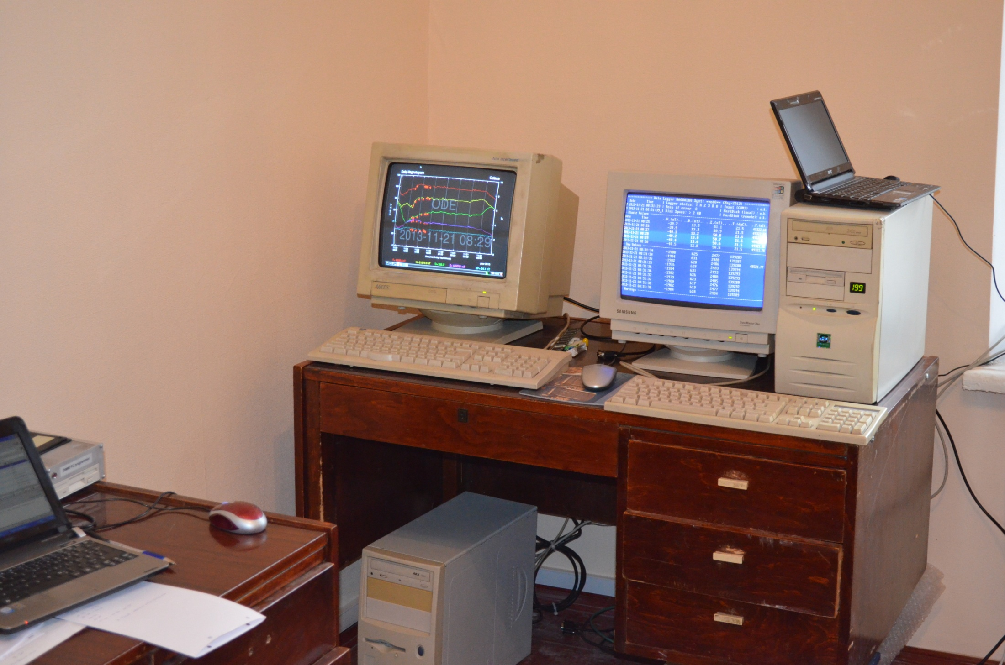

Slide 9
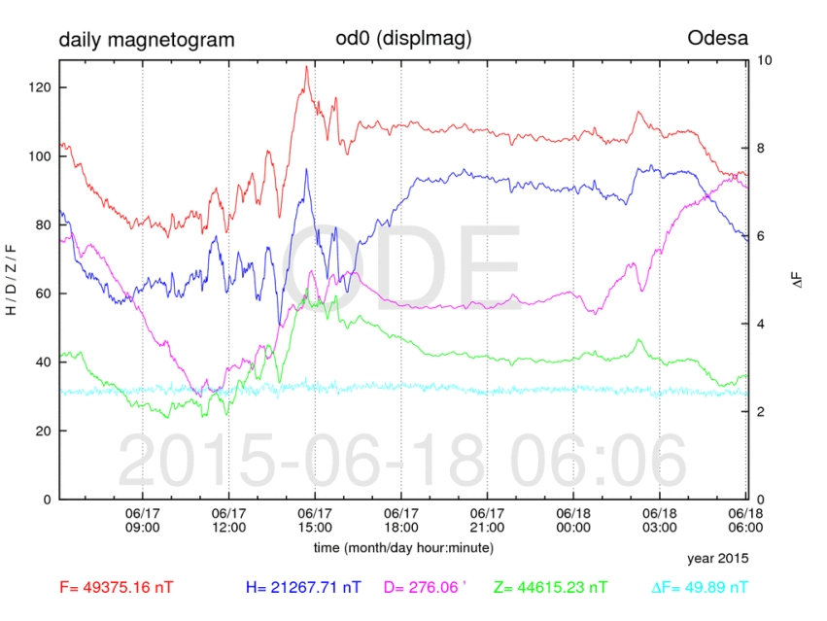

Slide 10
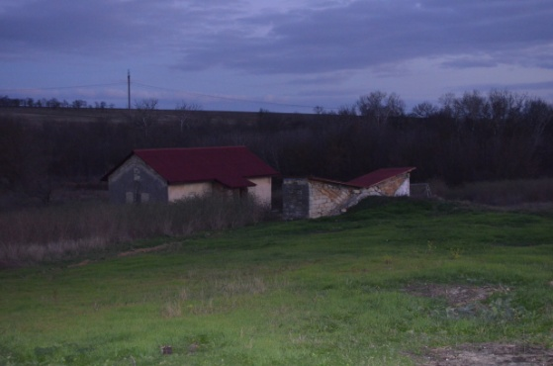
Absolute and variation pavilions

Slide 11
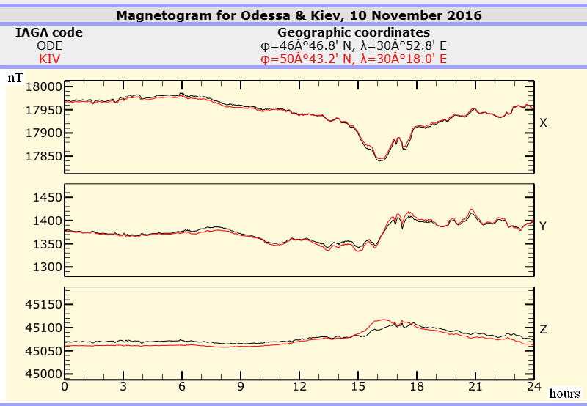

Slide 12
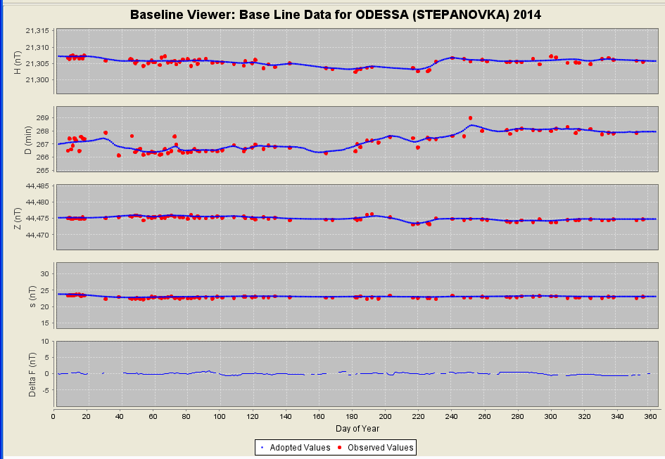

Slide 13
Process of determining adopted baselines
1) Manual review , removal of abnormal observations
2) Preliminary automatic calculation of adopted
baseline using moving average technique
3) Possible manual adjustment of automatic
calculations after visual inspecting

Slide 14
Conclusions
The geomagnetic observatory Odessa has a long series of data reaching back to 1948. It is valuable for studying long-period and secular variations.
The level of artificial noise at the observatory is very low.
Modern equipment has been installed at the observatory Odessa.
Since the end of 2013 data from observatory Odessa have been sent to Edinburg in IAGA2002 format.
The Application form, 12 month of definitive one-minute mean data , a baseline file, an annual mean file, and a readme file in INTERMAGNET formats have been prepared and submitted.
We hope that geomagnetic observatory Odessa will be accepted as full member of INTERMAGNET.
14

Slide 15
Acknowledgments
We express thanks to
Colleagues from Deutsches GeoForschungs Zentrum, Potsdam, Germany and from Institute of Geophysics, Polish Academy of Sciences, Warsaw, Poland for help in equipping the observatory “Odessa” of Institute of geophysics of NASU with instruments meeting INTERMAGNET standards.
Staff of the geomagnetic observatory “Niemegk” for help in installing the equipment.
Dr. Hans-Joachim Linthe for consultations and help to prepare application form.
Dr. Jan Reda and Mariusz Neska from IG PAS for help to prepare data from observatory “Odessa” according to INTERMAGNET standards.

Slide 16
Thank You for Your Attention!

